Slide 1
Population ageing in France:
Using NTA to assess the sustainability of the Social Security system
Hippolyte d’Albis
NTA Global Meeting, Feb 14th, 2023

Slide 2
A project with Julien Navaux, Jacques Pelletan and Pierre-Yves Cusset
For « France Stratégie » (Prime Minister’s administration)
Tasks:
Update the NTA profiles till 2019 (annual profiles since 1979)
Detail the Social Security spendings (Pensions, Medical coverage, Family policy, Employment policies)
Detail the Social Security incomes (taxes on labor, taxes on incomes)

Slide 3
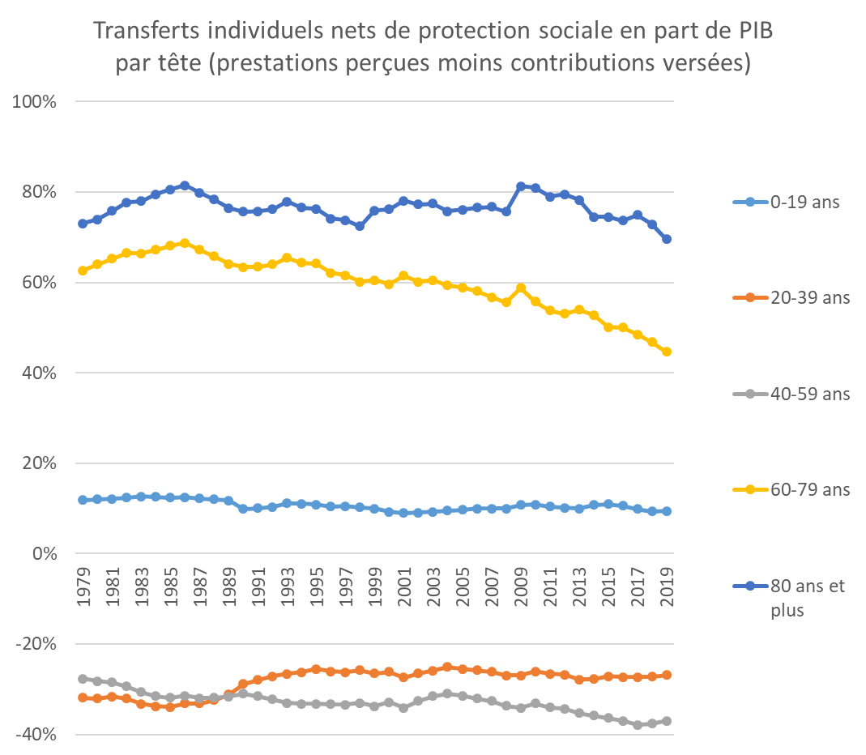
Average net transfer (inflows - outflows) as a share of GDP/capita
by age group, 1979-2019

Slide 4
A visualization tool by PY Cusset
https://francestrategie.shinyapps.io/CPS_PS_2022_v5_shiny_export/

Slide 5
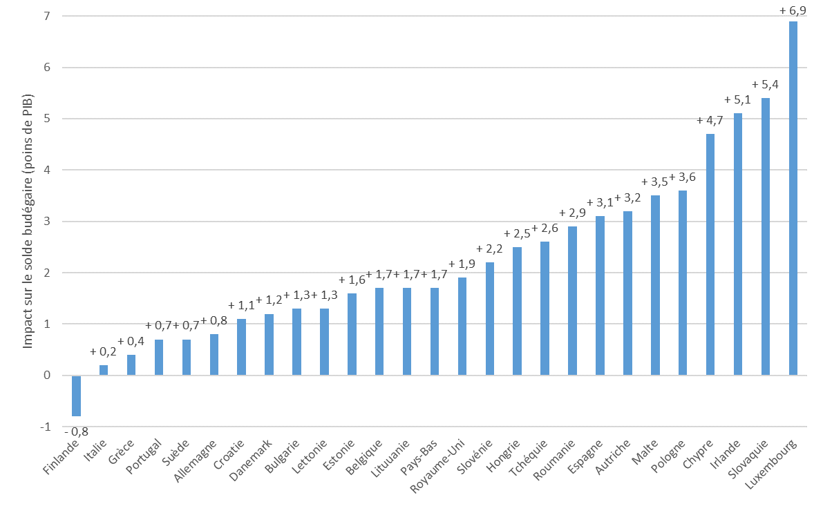
Modification of the fiscal balance of the system, for alternative demographic structures

